Slide 1
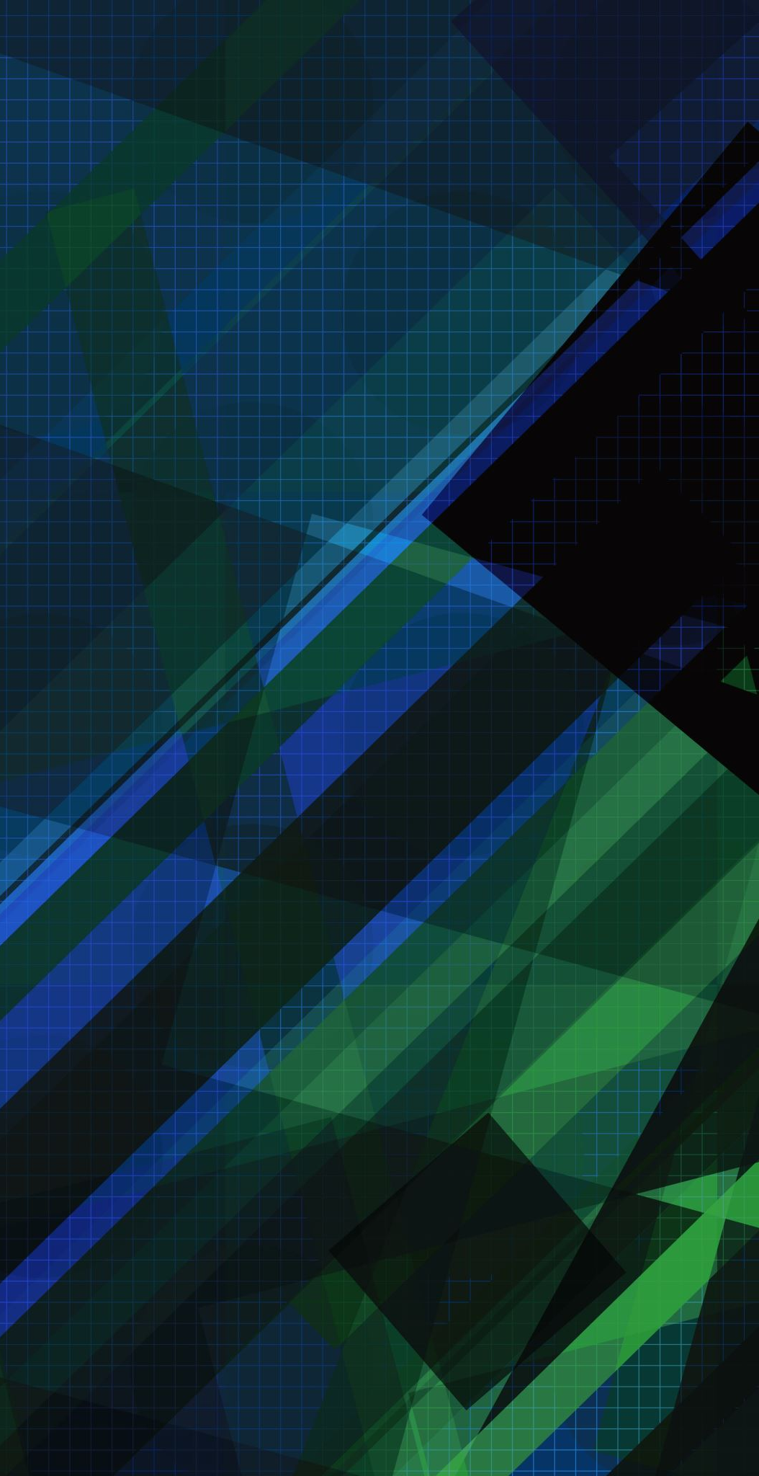
Mobile AI 2022: Monocular Depth Estimation
Denis Sapozhnikov

Slide 2
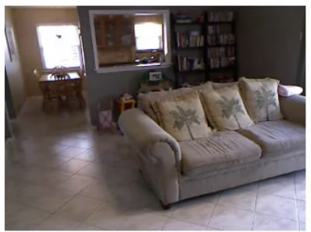
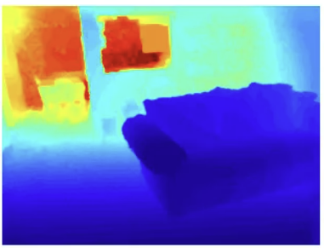
Motivation
Depth estimation has many applications from self-driving [Xue2020] to depth blur of photos [Huhle2009]
One of the most important applications is using depth estimation on mobile devices for bokeh effect [Ignatov2020], real-time AR games [Du2020] and so on. All this applications should work quick on low-performance devices
Mono depth estimation can be used on any device independent of numbers of cameras (but at least one) and independent of its location
[Xue2020] Xue, Feng, et al. "Toward hierarchical self-supervised monocular absolute depth estimation for autonomous driving applications." 2020 IEEE/RSJ International Conference on Intelligent Robots and Systems (IROS). IEEE, 2020.
[Huhle2009] Huhle, Benjamin, et al. "Realistic depth blur for images with range data." Workshop on Dynamic 3D Imaging. Springer, Berlin, Heidelberg, 2009.
[Ignatov2020] Ignatov, Andrey, Jagruti Patel, and Radu Timofte. "Rendering natural camera bokeh effect with deep learning." Proceedings of the IEEE/CVF Conference on Computer Vision and Pattern Recognition Workshops. 2020.
[Du2020] Du, Ruofei, et al. "DepthLab: Real-time 3D interaction with depth maps for mobile augmented reality." Proceedings of the 33rd Annual ACM Symposium on User Interface Software and Technology. 2020.

Slide 3
Introduction
Depth estimation can be reformulated as a regression for every pixel. Naïve approach yields quadratic number of starts the network to estimate depth for every pixel
The first revolution in this field was provided by a UNet [Ronneberger2015] architecture. It used two ideas:
Let’s decrease the resolution and increase the number of channels after each convolution
Let’s add a long skip-connections before UpSample layer
In our case we want to run network on mobile devices. The most famous architecture for mobile devices is Mobile Nets [Howard2017, Sandler2018, Howard2019]. A lot of ideas have been used to speed up a CNN from division of convolution layer into two parts to an architecture search using RL
[Ronneberger2015] Ronneberger, Olaf, Philipp Fischer, and Thomas Brox. "U-net: Convolutional networks for biomedical image segmentation." International Conference on Medical image computing and computer-assisted intervention. 2015.
[Howard2017] Howard, Andrew G., et al. "Mobilenets: Efficient convolutional neural networks for mobile vision applications." arXiv preprint arXiv:1704.04861 (2017).
[Sandler2018] Sandler, Mark, et al. "Mobilenetv2: Inverted residuals and linear bottlenecks." Proceedings of the IEEE conference on computer vision and pattern recognition. 2018.
[Howard2019] Howard, Andrew, et al. "Searching for mobilenetv3." Proceedings of the IEEE/CVF international conference on computer vision. 2019.

Slide 4
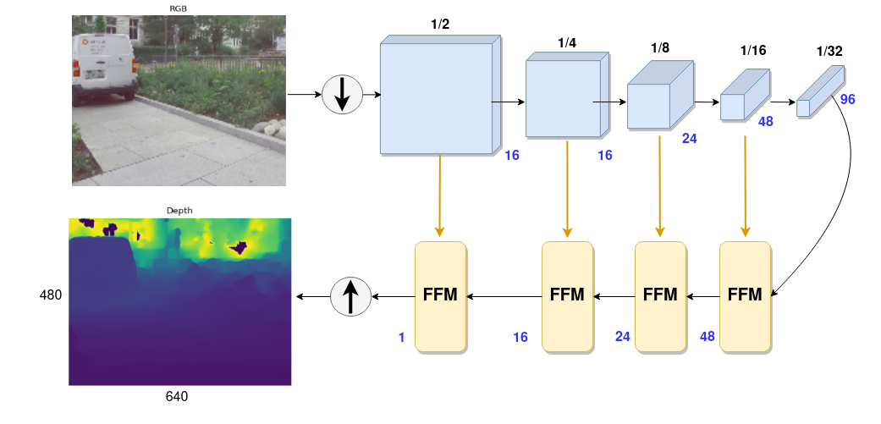
Final MODEL
Resize image to 128x160
Color Jitter, Random Rotate, Random Horizontal Flip and Gaussian Noise is a list of augmentations
Pretrained Mobile Net v3 Small encoder
UNet-like decoder with FFM blocks
Loss is combination of MSE, si-RMSE and SSIM losses
50 epochs of training loop with OneCycleLR scheduler and Adam Optimizer
5.707 score on validation dataset

Slide 5
What did we try?
And more details about model

Slide 6
Image Preprocessing
Resize Image to 128x160 – makes runtime 4x quicker
Random Horizontal Flip with probability 0.5
Color Jitter with the following parameters: brightness=0.2, contrast=0.2, saturation=0.2, hue=0.1
Gaussian Noise with variance from [0.01,0.015, 0.02] uniformly and with 0-mean
Random Rotate by [-5°;5°] degrees
Normalization by channels for pretrained Mobile Net Encoder

Slide 7
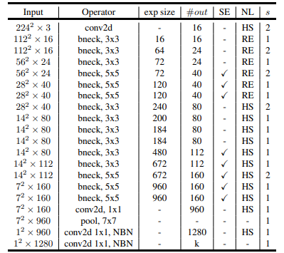
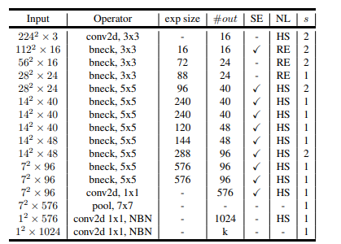
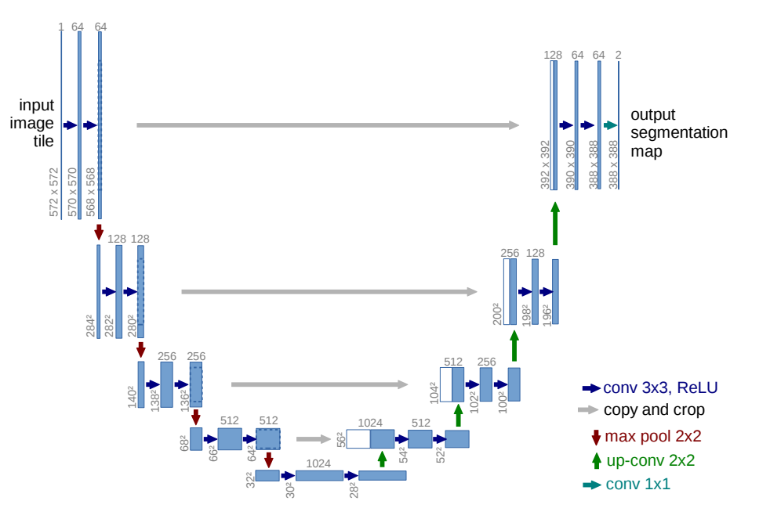
Encoders
UNet – bad quality
Mobile Net v3 Large – slow
Mobile Net v3 Small – good balance between quality and running time

Slide 8
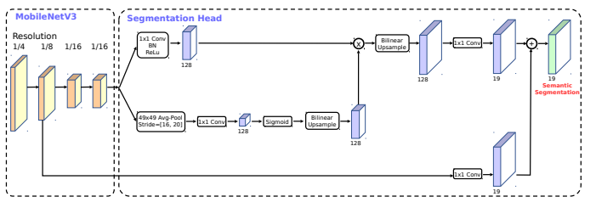
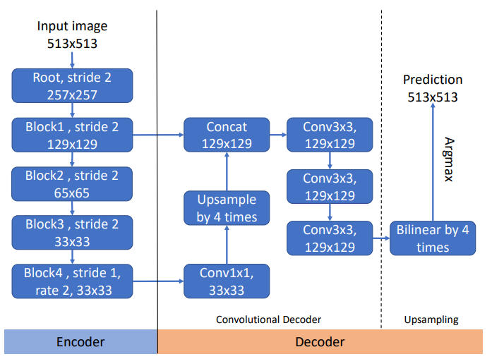
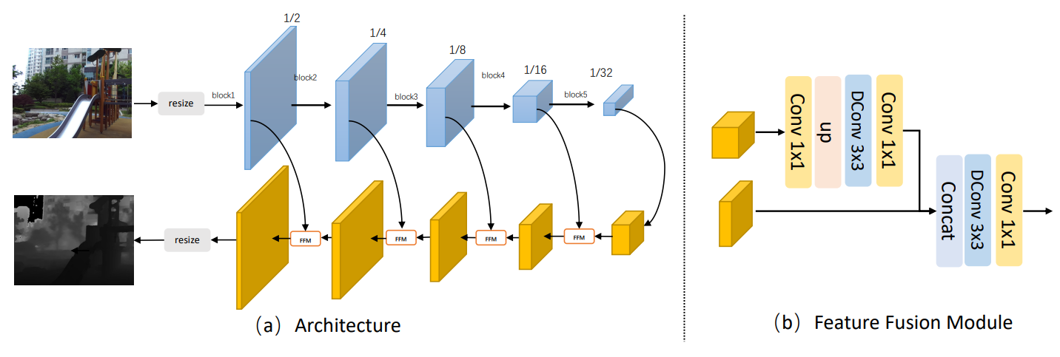
Decoders
Mobile Net v3
UNet
DeepLab v3+ [Chen2018]
UNet + FFM [Zhang2021]
[Chen2018] Chen, Liang-Chieh, et al. "Encoder-decoder with atrous separable convolution for semantic image segmentation." Proceedings of the European conference on computer vision (ECCV). 2018.
[Zhang2021] Zhang, Ziyu, et al. "A simple baseline for fast and accurate depth estimation on mobile devices." Proceedings of the IEEE/CVF Conference on Computer Vision and Pattern Recognition. 2021.

Slide 9
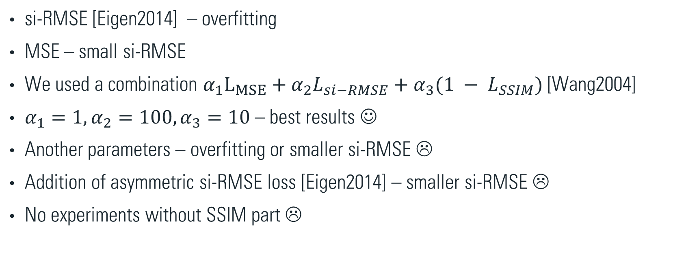
Loss
si-RMSE [Eigen2014] – overfitting
MSE – small si-RMSE
We used a combination $α_{1}L_{MSE}+α_{2}L_{si−RMSE}+{α_{3}(1 − L}_{SSIM})$ [Wang2004]
$α_{1}=1,α_{2}=100,α_{3}=10$ – best results ☺
Another parameters – overfitting or smaller si-RMSE ☹
Addition of asymmetric si-RMSE loss [Eigen2014] – smaller si-RMSE ☹
No experiments without SSIM part ☹
[Wang2004] Wang, Zhou, et al. "Image quality assessment: from error visibility to structural similarity." IEEE transactions on image processing 13.4 (2004): 600-612.
[Eigen2014] Eigen, David, Christian Puhrsch, and Rob Fergus. "Depth map prediction from a single image using a multi-scale deep network." Advances in neural information processing systems 27 (2014).

Slide 10
Knowledge distillation
We tried to add another term to loss like MSE error between feature map of our encoder and another big model for Depth Estimation. Teacher network was a GLPN model [Kim2022] which achieved one of the highest quality on NYUv2 dataset [Silberman2012].
On intermediate models, this did give an increase in quality. However, in the final model, this did not give any changes ☹
[Kim2022] Kim, Doyeon, et al. "Global-Local Path Networks for Monocular Depth Estimation with Vertical CutDepth." arXiv preprint arXiv:2201.07436 (2022).
[Silberman2012] Silberman, Nathan, et al. "Indoor segmentation and support inference from rgbd images." European conference on computer vision. Springer, Berlin, Heidelberg, 2012.

Slide 11
What not should do IN this Challenge?
Using just one simple term in loss – overfitting or small score
Using small number of augmentations – fast overfitting and small score
Using big validation dataset – worse score
Tanh > sigmoid [LeCun2012]
Learning rate must decreasing during training
Many epochs of pretrained model don’t give a higher score
[LeCun2012] LeCun, Yann A., et al. "Efficient backprop." Neural networks: Tricks of the trade. Springer, Berlin, Heidelberg, 2012.

Slide 12
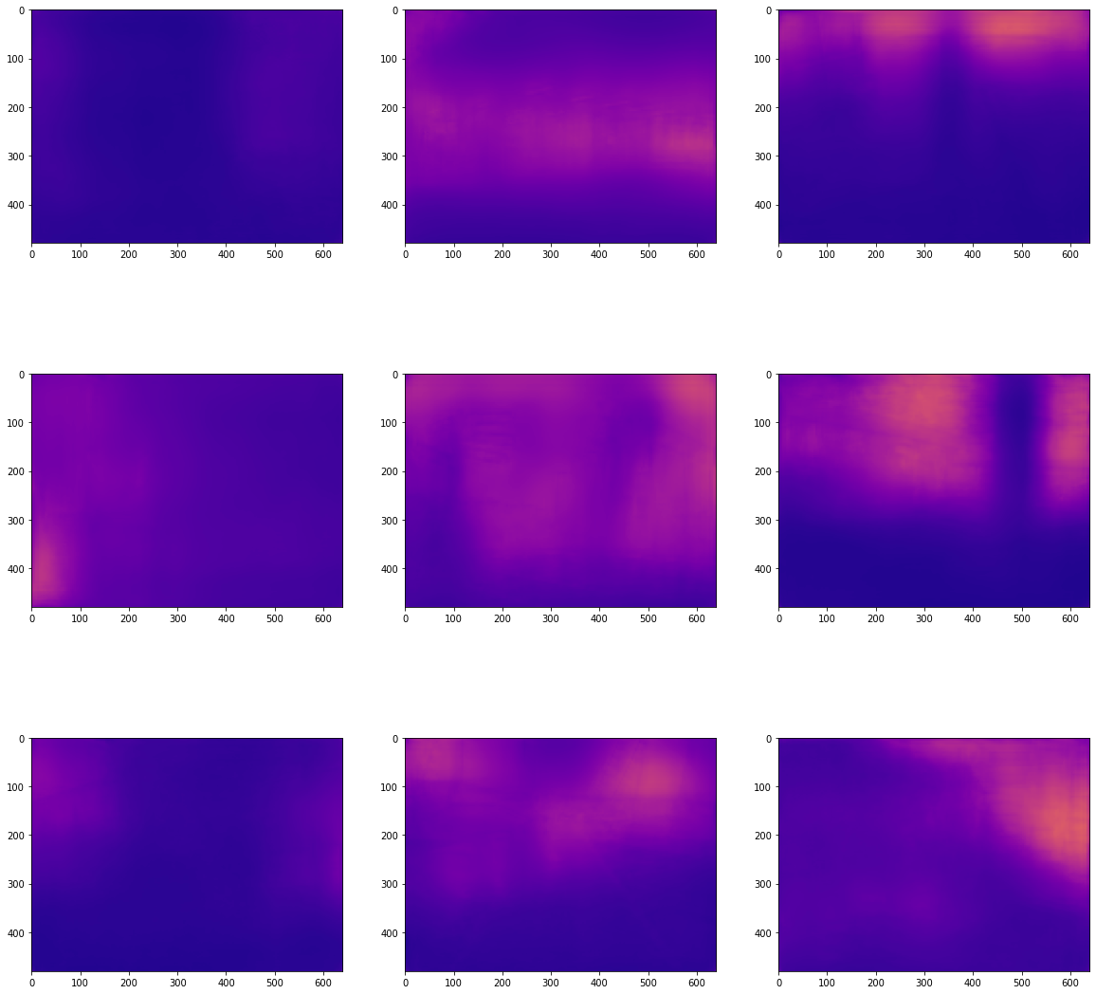
FUTHER WORK
Alternative decoder (HRNet [Wang2020], Mobile UNet [Jing2022] et al.)
More efficient first layer(s) which will work on higher resolutions without lost of runtime
Compressing of encoder [Howard2017, Zhang2021]
Alternative KD [Lee2019]
More experiments with losses [Shu2020, Niklaus2019]
More data [Geiger2013]
Another augmentations (for example, Random Crop)
[Wang2020] Wang, Jingdong, et al. "Deep high-resolution representation learning for visual recognition." IEEE transactions on pattern analysis and machine intelligence 43.10 (2020)
[Jing2022] Jing, Junfeng, et al. "Mobile-Unet: An efficient convolutional neural network for fabric defect detection." Textile Research Journal 92.1-2 (2022)
[Howard2017] Howard, Andrew G., et al. "Mobilenets: Efficient convolutional neural networks for mobile vision applications." arXiv preprint arXiv:1704.04861 (2017).
[Zhang2021] Zhang, Ziyu, et al. "A simple baseline for fast and accurate depth estimation on mobile devices." Proceedings of the IEEE/CVF Conference on Computer Vision and Pattern Recognition. 2021.
[Lee2019] Lee, Jin Han, et al. "From big to small: Multi-scale local planar guidance for monocular depth estimation." arXiv preprint arXiv:1907.10326 (2019).
[Shu2020] Shu, Chang, et al. "Feature-metric loss for self-supervised learning of depth and egomotion." European Conference on Computer Vision. Springer, Cham (2020).
[Niklaus2019] Niklaus, Simon, et al. "3d ken burns effect from a single image." ACM Transactions on Graphics (ToG) 38.6 (2019).
[Geiger2013] Geiger, Andreas, et al. "Vision meets robotics: The kitti dataset." The International Journal of Robotics Research 32.11 (2013).

Slide 13
References
[Xue2020] Xue, Feng, et al. "Toward hierarchical self-supervised monocular absolute depth estimation for autonomous driving applications." 2020 IEEE/RSJ International Conference on Intelligent Robots and Systems (IROS). IEEE, 2020.
[Huhle2009] Huhle, Benjamin, et al. "Realistic depth blur for images with range data." Workshop on Dynamic 3D Imaging. Springer, Berlin, Heidelberg, 2009.
[Ignatov2020] Ignatov, Andrey, Jagruti Patel, and Radu Timofte. "Rendering natural camera bokeh effect with deep learning." Proceedings of the IEEE/CVF Conference on Computer Vision and Pattern Recognition Workshops. 2020.
[Du2020] Du, Ruofei, et al. "DepthLab: Real-time 3D interaction with depth maps for mobile augmented reality." Proceedings of the 33rd Annual ACM Symposium on User Interface Software and Technology. 2020.
[Ronneberger2015] Ronneberger, Olaf, Philipp Fischer, and Thomas Brox. "U-net: Convolutional networks for biomedical image segmentation." International Conference on Medical image computing and computer-assisted intervention. 2015.
[Howard2017] Howard, Andrew G., et al. "Mobilenets: Efficient convolutional neural networks for mobile vision applications." arXiv preprint arXiv:1704.04861 (2017).
[Sandler2018] Sandler, Mark, et al. "Mobilenetv2: Inverted residuals and linear bottlenecks." Proceedings of the IEEE conference on computer vision and pattern recognition. 2018.
[Howard2019] Howard, Andrew, et al. "Searching for mobilenetv3." Proceedings of the IEEE/CVF international conference on computer vision. 2019.
[Chen2018] Chen, Liang-Chieh, et al. "Encoder-decoder with atrous separable convolution for semantic image segmentation." Proceedings of the European conference on computer vision (ECCV). 2018.
[Zhang2021] Zhang, Ziyu, et al. "A simple baseline for fast and accurate depth estimation on mobile devices." Proceedings of the IEEE/CVF Conference on Computer Vision and Pattern Recognition. 2021.
[Wang2004] Wang, Zhou, et al. "Image quality assessment: from error visibility to structural similarity." IEEE transactions on image processing 13.4 (2004): 600-612.
[Eigen2014] Eigen, David, Christian Puhrsch, and Rob Fergus. "Depth map prediction from a single image using a multi-scale deep network." Advances in neural information processing systems 27 (2014).
[Kim2022] Kim, Doyeon, et al. "Global-Local Path Networks for Monocular Depth Estimation with Vertical CutDepth." arXiv preprint arXiv:2201.07436 (2022).
[Silberman2012] Silberman, Nathan, et al. "Indoor segmentation and support inference from rgbd images." European conference on computer vision. Springer, Berlin, Heidelberg, 2012.
[LeCun2012] LeCun, Yann A., et al. "Efficient backprop." Neural networks: Tricks of the trade. Springer, Berlin, Heidelberg, 2012.
[Wang2020] Wang, Jingdong, et al. "Deep high-resolution representation learning for visual recognition." IEEE transactions on pattern analysis and machine intelligence 43.10 (2020)
[Jing2022] Jing, Junfeng, et al. "Mobile-Unet: An efficient convolutional neural network for fabric defect detection." Textile Research Journal 92.1-2 (2022)
[Zhang2021] Zhang, Ziyu, et al. "A simple baseline for fast and accurate depth estimation on mobile devices." Proceedings of the IEEE/CVF Conference on Computer Vision and Pattern Recognition. 2021.
[Lee2019] Lee, Jin Han, et al. "From big to small: Multi-scale local planar guidance for monocular depth estimation." arXiv preprint arXiv:1907.10326 (2019).
[Shu2020] Shu, Chang, et al. "Feature-metric loss for self-supervised learning of depth and egomotion." European Conference on Computer Vision. Springer, Cham (2020).
[Niklaus2019] Niklaus, Simon, et al. "3d ken burns effect from a single image." ACM Transactions on Graphics (ToG) 38.6 (2019).
[Geiger2013] Geiger, Andreas, et al. "Vision meets robotics: The kitti dataset." The International Journal of Robotics Research 32.11 (2013).

